Slide 1



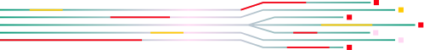

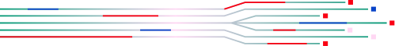
Intro to React
REACT HOOKS

Slide 2


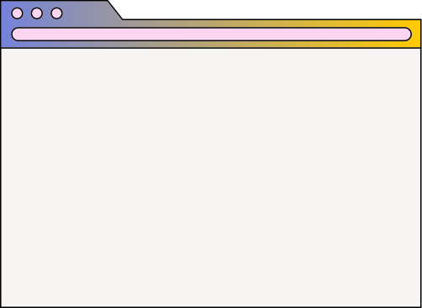

INDEX
01
02
03
04
Understanding Hooks
Examples of Hooks
Rules of hooks
Hands on

Slide 3


INTRODUCTION
DEFINITION
Hooks are like tools that help make coding in React easier. They are especially useful for managing data and making sure things happen in the right order.
PURPOSE
Simplified State Management
Efficient Side Effect Handling
Improved Code Readability
Improved Code Optimization

Slide 4


BEFORE HOOKS
01
02
03
Complexity of Class Components
Code Duplication
Difficulty in Reusing Logic

Slide 5
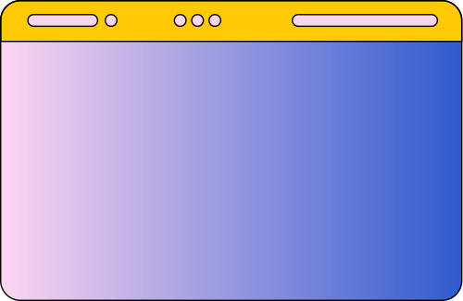
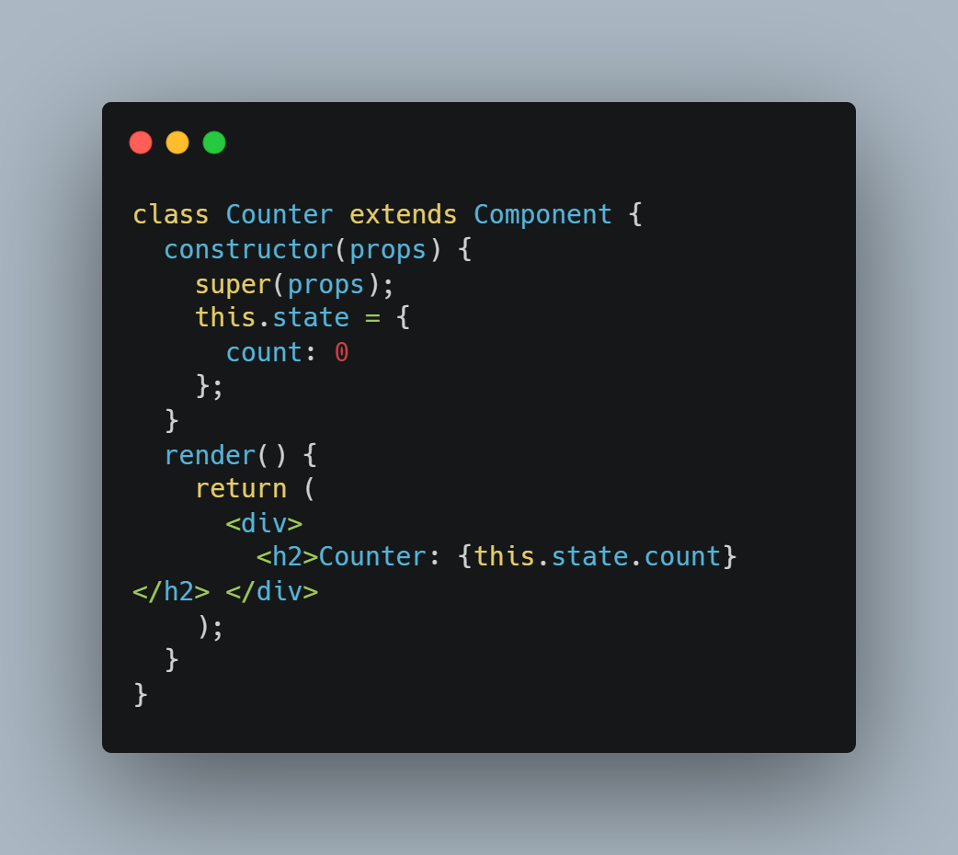
EXAMPLE

Slide 6


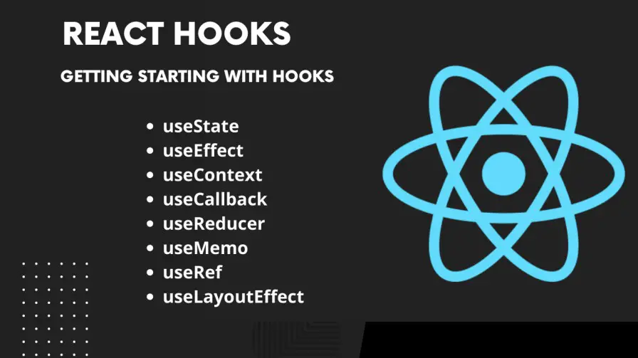


REACT HOOKS

Slide 7


USESTATE
Value
1
The value of state lies in its ability to store information within an application
STATE
2
The state setter enables dynamic updates and synchronization of state change
Setter

Slide 8
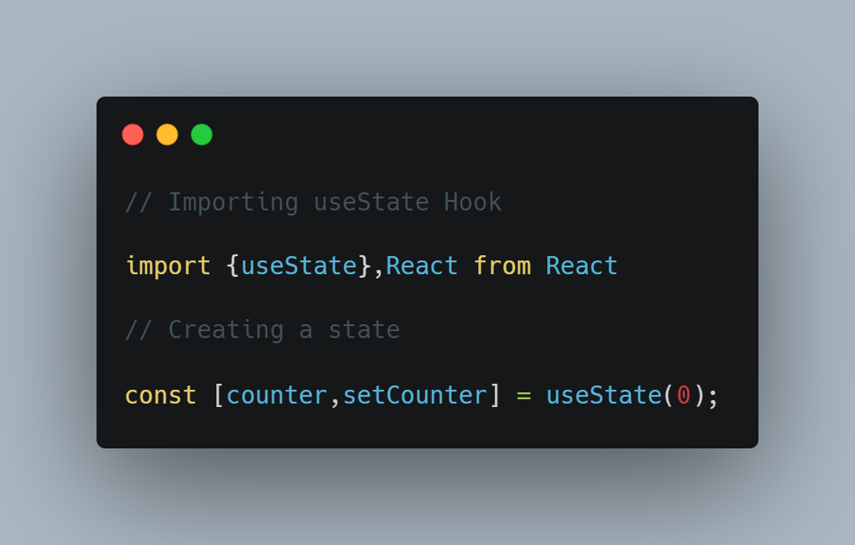
USAGE

Slide 9
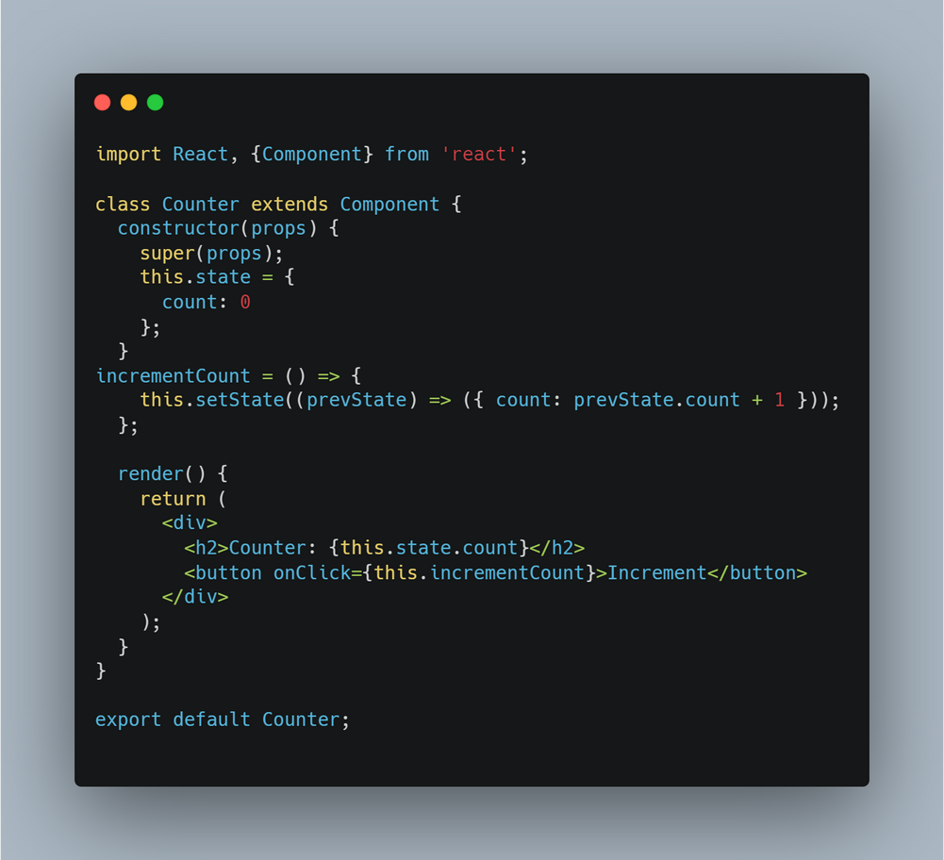
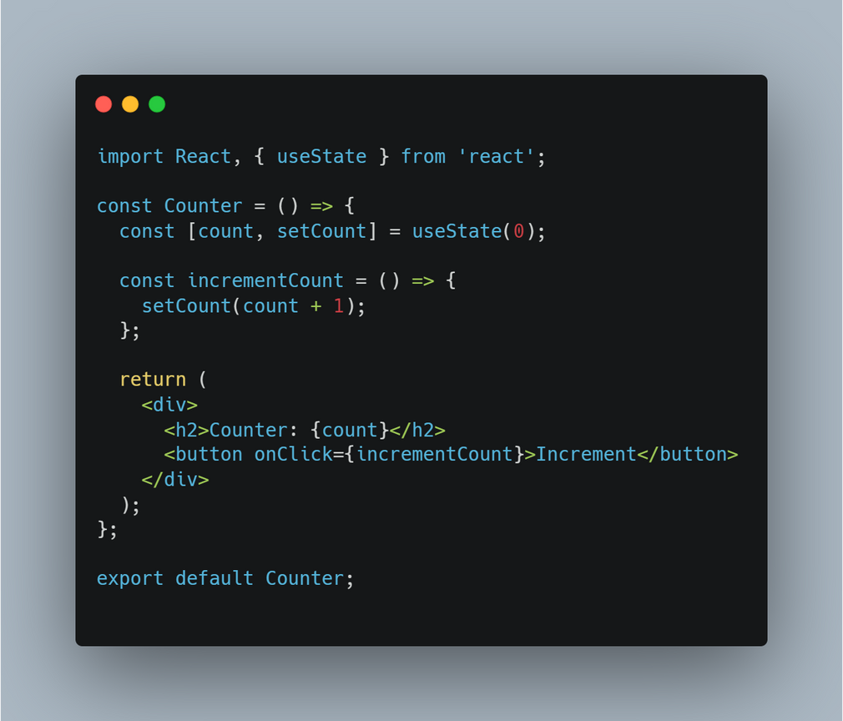
DIFFERENCE MADE
==>

Slide 10
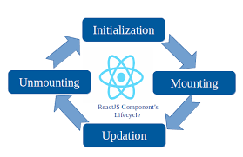

USE EFFECT

Slide 11
USE EFFECT
01
Mount
useEffect with an empty dependency array runs once when the component mounts, handling initial setup tasks.
02
useEffect with dependencies runs when specified state variables or props change, allowing for dynamic updates and side effects.
Update
03
Unmount
useEffect with a cleanup function runs when the component unmounts, ensuring proper cleanup of resources and preventing memory leaks.

Slide 12
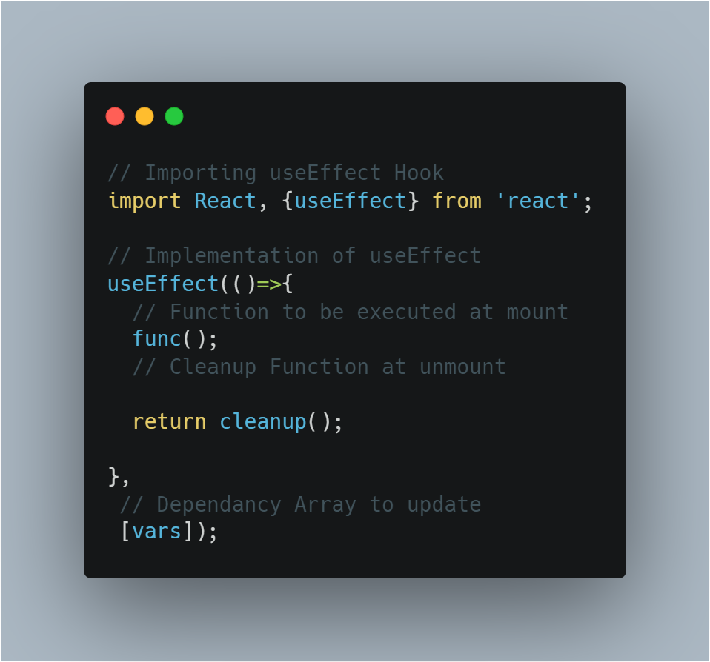
USAGE

Slide 13
RULES OF HOOKS
1
Hooks should be called directly within the top level of functional components.
Top-Level Calling
2
Hooks are meant to be used only within React functional components or custom hooks.
React Function Context
3
Custom hooks should follow the "use" prefix naming convention for clarity and consistency.
Naming Convention

Slide 14
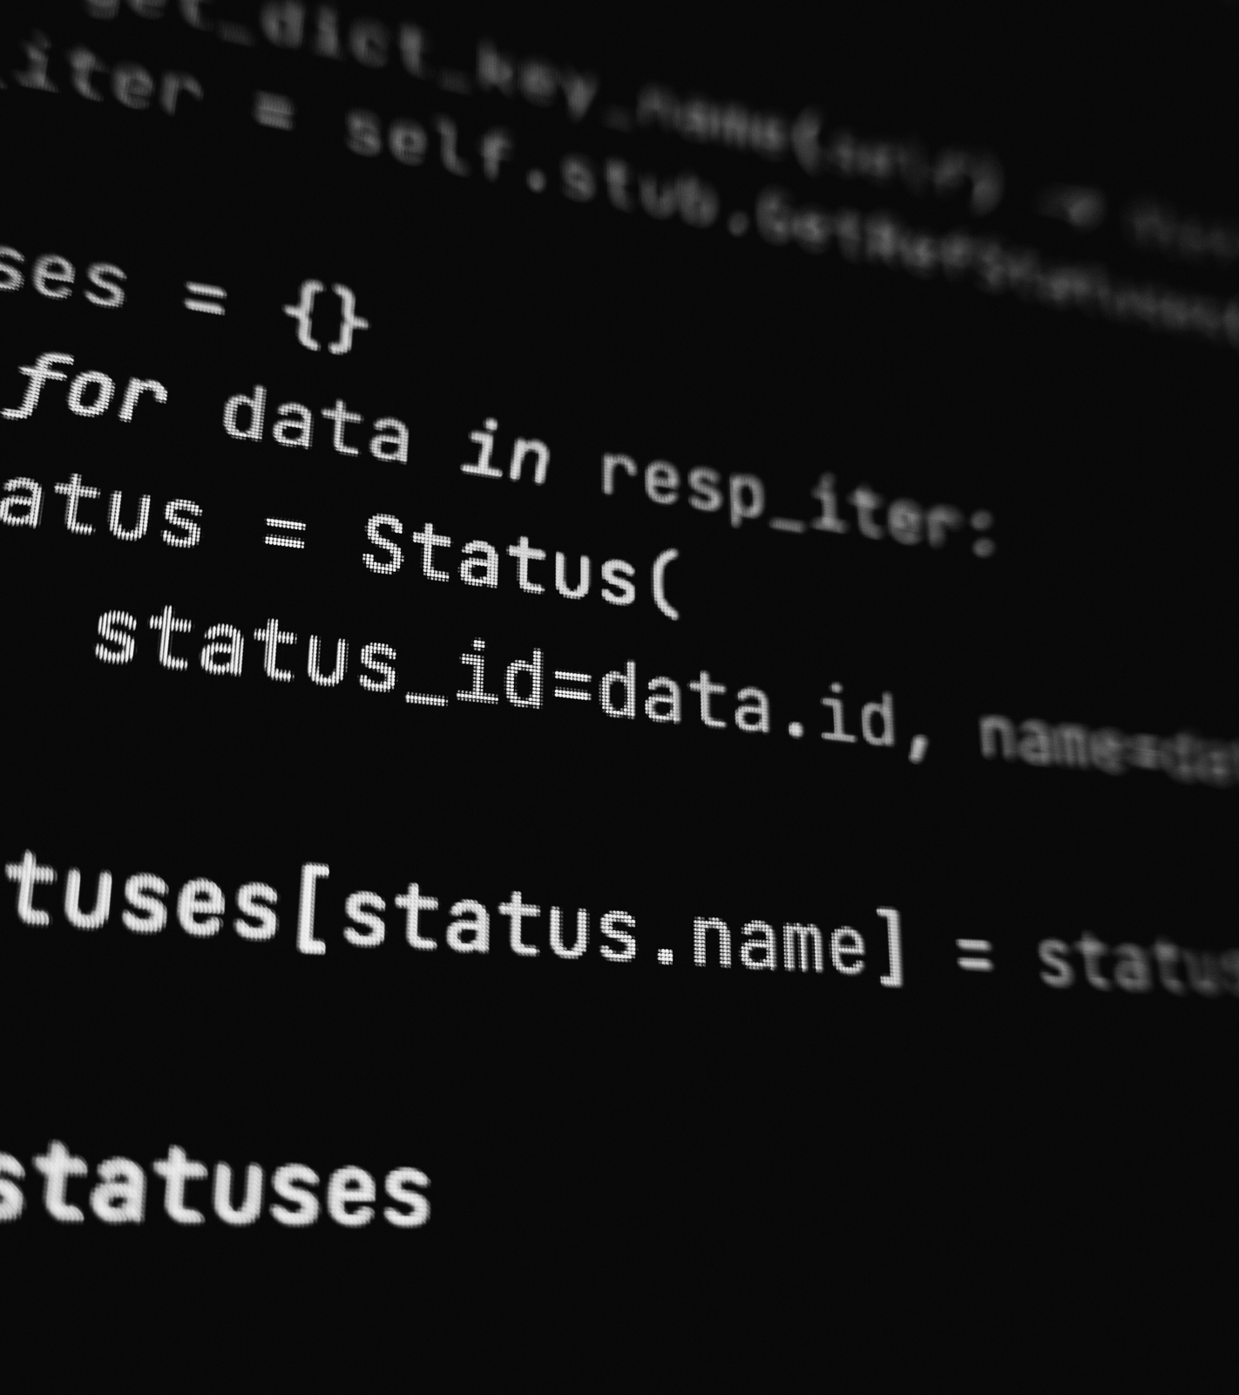

HANDS
ON !

Slide 15


THANK YOU
By Salmen Abbes

